Slide 1
W+
W+

Slide 2
Okay, what?

Slide 3
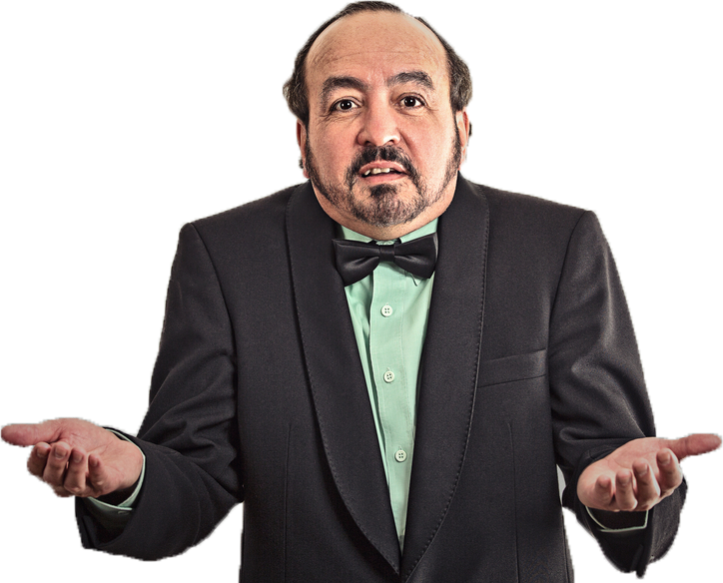
Why tho?

Slide 4
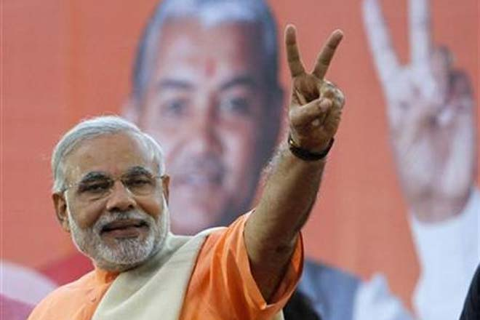
TWO MAIN REASONS

Slide 5
Population (not to scale)
WEB DEVELOPERS
CHINA
INDIA
People watching Bigg Boss

Slide 6


One JavaScript to rule them all

Slide 7
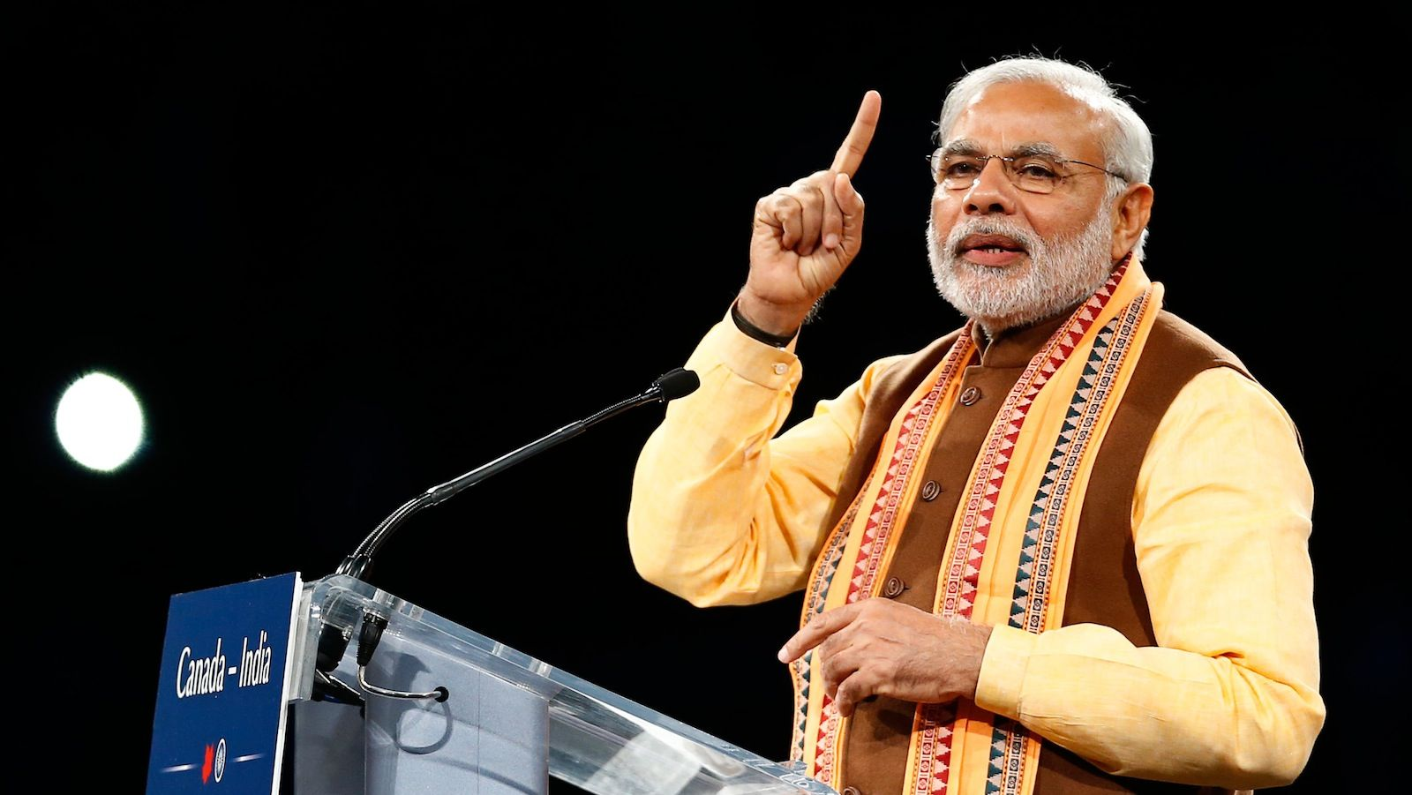
ONE MORE REASON

Slide 8

WARNING

Slide 9








Slide 10


Slide 11


Slide 12


Slide 13
FAQs
“What if I have done a bit of
HTML and CSS in school?”

Slide 14
FAQs
“What if I already know everything about Web Dev?”

Slide 15
FAQs
“What if I don’t know
anything at all ☹ ?“

Slide 16








Text Editor
Good Browser
Image Editing*
Version Control

Slide 17

CASUALLY SPEAKING
Web Designer
Shares food
Shows you new music
Designs the User Interface

Slide 18

CASUALLY SPEAKING
Front End Developer
- Into Rick and Morty
Never eats in the mess
Implements the design

Slide 19

CASUALLY SPEAKING
Back End Developer
Great sense of humour
Kind hearted
Makes the website functional

Slide 20


THE THREE HORSEMEN
HTML
Before ANYTHING else
Every website uses it
Super easy and quick to learn
Define elements on the screen

Slide 21


THE THREE HORSEMEN
CSS
Used to modify the appearance of HTML elements
Makes website responsive
Super efficient and easy
Offers a huge variety of options

Slide 22
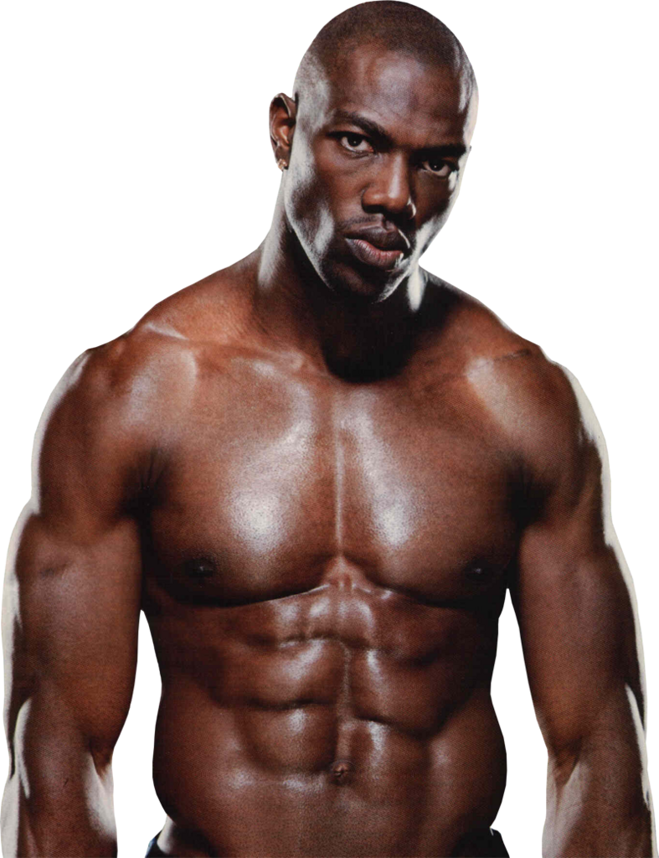

THE THREE HORSEMEN
JavaScript
Very very very powerful
Like the Goku of languages
Can literally do anything you want.

Slide 23
HTML
The skeleton of the webpage.
Set of instructions
<tags>, <tags> and more <tags>
Browser reads the instruction, renders output
Attribute Value
<font color=“red”> Yo this red </font>
Opening Tag
Closing Tag

Slide 24
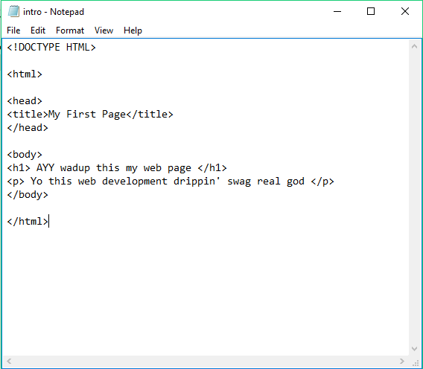
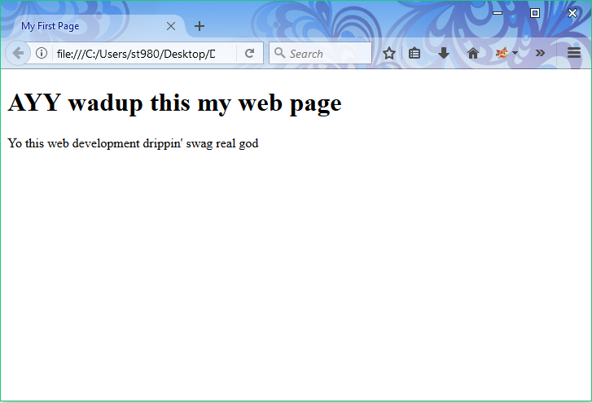
HTML
THIS IS HOW YOU WILL DISPLAY
SURE!

Slide 25
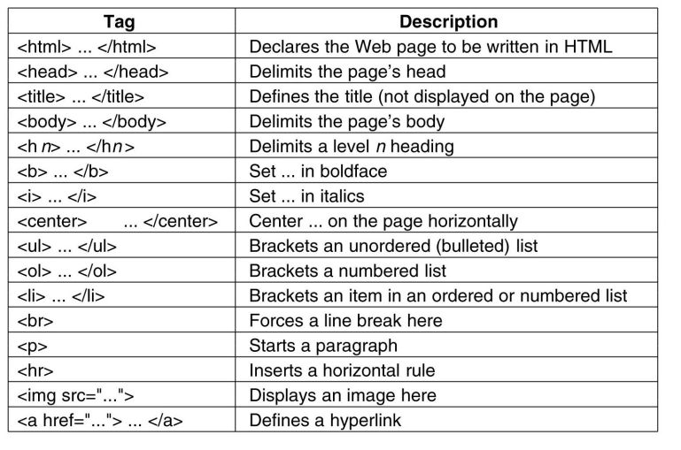

Slide 26
CSS
Attribute Value
Cascading Style Sheet
Controls the appearance
Everything from colour to animation
color : white;

